Slide 1
Tables In HTML
Create Tables | Spanning multiple columns and rows | Header, body, and footer
Notes:
Welcome to our lecture on Tables in HTML. In this lecture we will go through the tables, and tags used to make tables in html, Spanning multiple columns and rows, and finally the header body and footer of table. Let’s start today’s lecture.

Slide 2

Tables in HTML
HTML tables organize data into rows and columns using the table tag.
A cell is a specific location in a table at a row and column intersection.
The <tr> element creates a table row containing all its cells.
Notes:
HTML tables are used to organize data in rows and columns. They are created using the table tag. Each cell is a specific location in the table, determined by its row and column. Rows are defined using the tr element, which groups all cells in that row. Tables help structure and present data clearly, making it easy to display and understand information on a webpage.

Slide 3
Tables in HTML
The <th> element creates header cells, typically bold and centered.
The <td> element creates cells for table data.
The <caption> element adds a short descriptive title for the table.
Notes:
The t h element creates header cells, which are typically bold and centered to highlight table headings. The t d element is used for creating cells that contain the table's main data. The caption element provides a short descriptive title for the table, offering context or summary information for better understanding. These elements work together to structure and describe table data effectively.

Slide 4
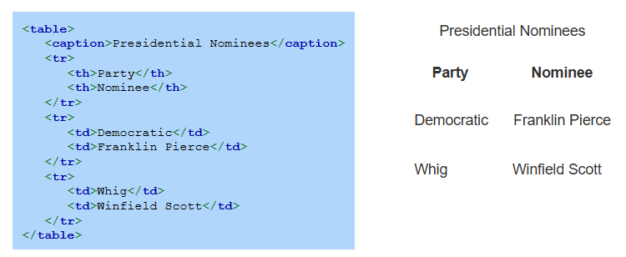
Example
Notes:
Here is the example of table that includes a caption element labeled Presidential Nominees to provide a title for the table. The first row uses t h elements for the headers Party and Nominee. Subsequent rows use td elements to display data, such as Democratic and Franklin Pierce or Whig and Winfield Scott. This structure clearly organizes and presents tabular data.

Slide 5
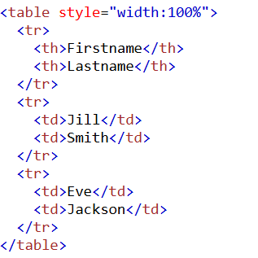
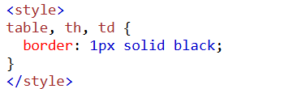
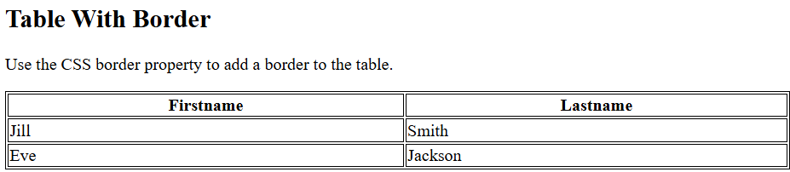
Table Borders
CSS can be added to a webpage to display table borders.
Notes:
This example shows CSS can be used to add borders to tables on a webpage. The table element contains rows and columns, with headers defined using table header and data cells using table data. The CSS rule sets a 1 pixel solid black border for the table, headers, and data cells, enhancing the table's visual appearance. Using the style attribute inline or a style block ensures proper styling for better readability.

Slide 6
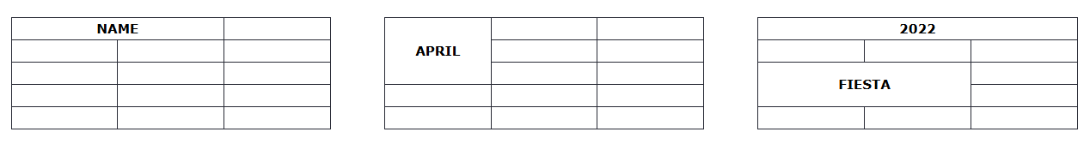
Spanning multiple columns and rows
A table cell occupies one row and column by default but can span multiple columns or rows using the colspan and rowspan attributes.
The colspan and rowspan attributes are used with <td> and <th> elements.
Notes:
Now move on to row and column spanning. A table cell usually occupies one row and column but can span multiple rows or columns using the colspan and rowspan attributes. These attributes are applied to t d and t h elements to merge cells, creating more flexible layouts. For example, you can create headers spanning several columns or rows to organize table content effectively as shown in figures below.

Slide 7
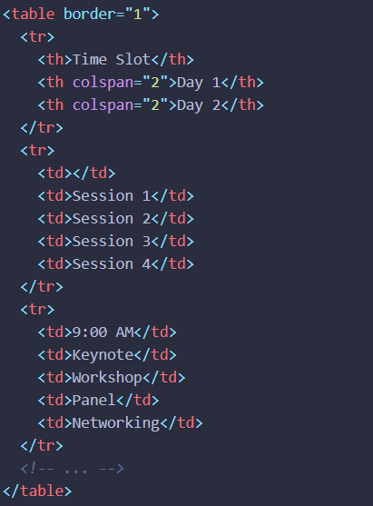
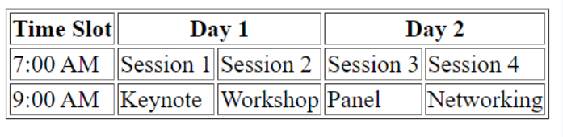
Column Span Example
Notes:
This example demonstrates the use of the col span attribute in HTML tables to merge columns. The table organizes sessions by time slots and days. The col span equal to 2 attribute in the t h elements merges two columns for Day 1 and Day 2 headers, creating a cleaner layout. This technique is useful for structuring data hierarchically, enhancing readability and organization in complex tables.

Slide 8
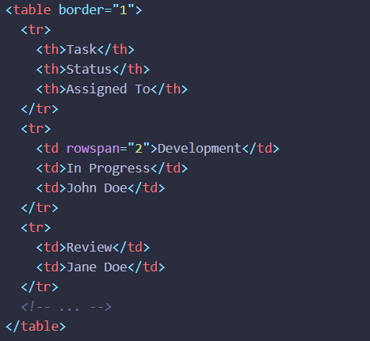
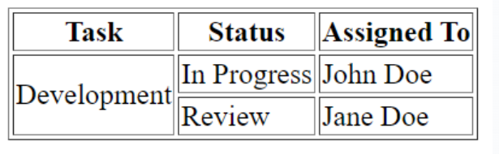
Row Span Example
Notes:
This example demonstrates the use of the row span attribute in HTML tables to merge rows. The Development task spans two rows using row span equal to 2 in the t d element, associating it with both statuses, In Progress and Review. This technique helps to organize data effectively in tables, especially when a single value applies to multiple rows, improving clarity and reducing redundancy in the layout.

Slide 9
Header, body, and footer
Three optional table tags specify each part of a table:
The <thead> element specifies the table header.
The <tbody> element specifies the table body.
The <tfoot> element specifies the table footer.
Notes:
Let us now discuss the optional tags that divide a table into sections. The ttable head element specifies the table header, often used for column titles. The table body element defines the table body, which contains the main data rows. Lastly, the table foot element represents the table footer, commonly used for summary or totals. These tags help organize and structure tables for better readability.

Slide 10
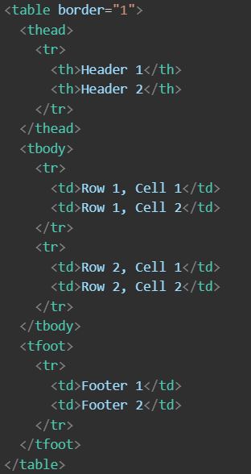
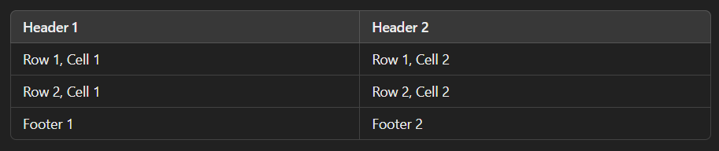
Example
Output Table
Notes:
This example demonstrates the use of table head, table body, and table foot elements in a table. The table head section defines headers, such as Header 1 and Header 2. The table body section contains rows of data, with cells like Row 1 Cell 1 and Row 2 Cell 2. Lastly, the table foot section displays footer content, such as Footer 1 and Footer 2. This structure organizes the table into clear, logical parts. Thanks for watching the lecture.

